Slide 1

VA Data Analysis
Derya Ferendeci
Jasmine Williamson
Megan Payich

Slide 2



VA Data Explanation
Data Preparation
ER Diagram
ETL
Machine Learning

Slide 3




Introduction
We selected this topic because the Veteran population and VA benefits are always a talking point for legislators. It will be interesting to break down the data, look at some trends and predict what the future can look like for Veterans and their benefits within VA Healthcare. Specifically, we are going to use the following to predict each hospital performance: expenditures, unique patient data, patient experience and employee satisfaction .

Slide 4
Each fiscal year the Department of Veterans Affairs’ Office of Policy and Planning publishes the annual Geographic Distribution of VA Expenditures (GDX) Report for the public and all stakeholders.
The GDX report provides the estimated dollar expenditures for major VA programs at the state, county, and Congressional District levels.
Expenditure data are grouped by the following categories: Compensation and Pension; Education and Vocational Rehabilitation and Employment; Insurance and Indemnities; Construction and Related Costs; General Operating Expenses and Related Costs; Loan Guaranty; and Medical Expenditures.
Strategic Analytics for Improvement and Learning Value Model or SAIL, is a system for summarizing hospital system performance within Veterans Health Administration (VHA). SAIL assesses key Quality measures in areas such as death rate, complications, and patient satisfaction, as well as overall efficiency at individual VA Medical Centers (VAMCs).Each VA medical center is given an Efficiency score 0-100. We will use Linear regression to predict the efficiency score (0-100) of a VA medical center based on factors such as expenditures, unique patient data, patient experience, and employee satisfaction. The GDX Report also includes Veteran population estimates at the state, county and Congressional District level and the number of unique patients who used VA health care services.

Slide 5

VA DATA

Slide 6
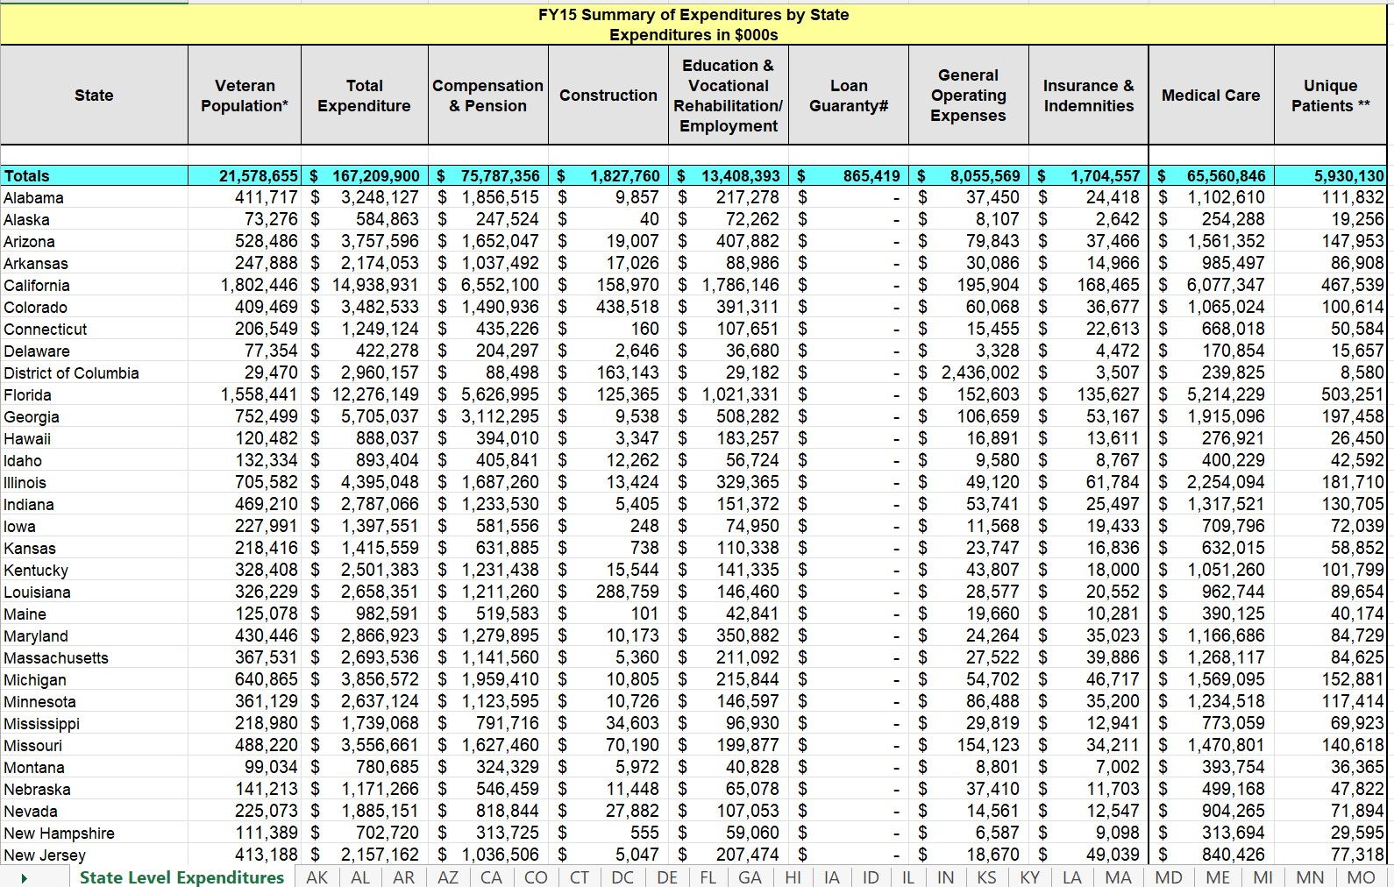
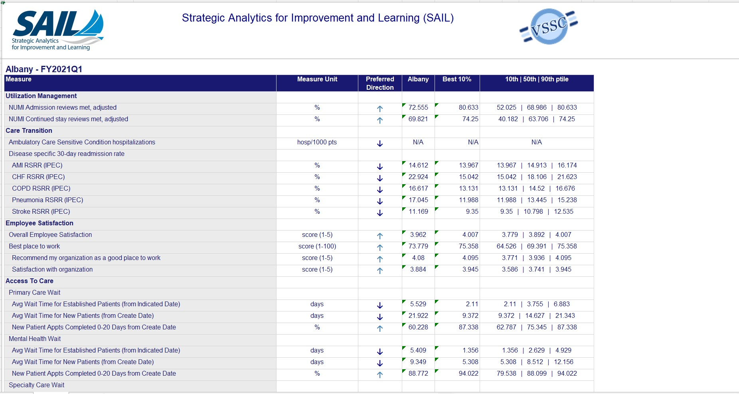
GDX Report SAIL Data

Slide 7
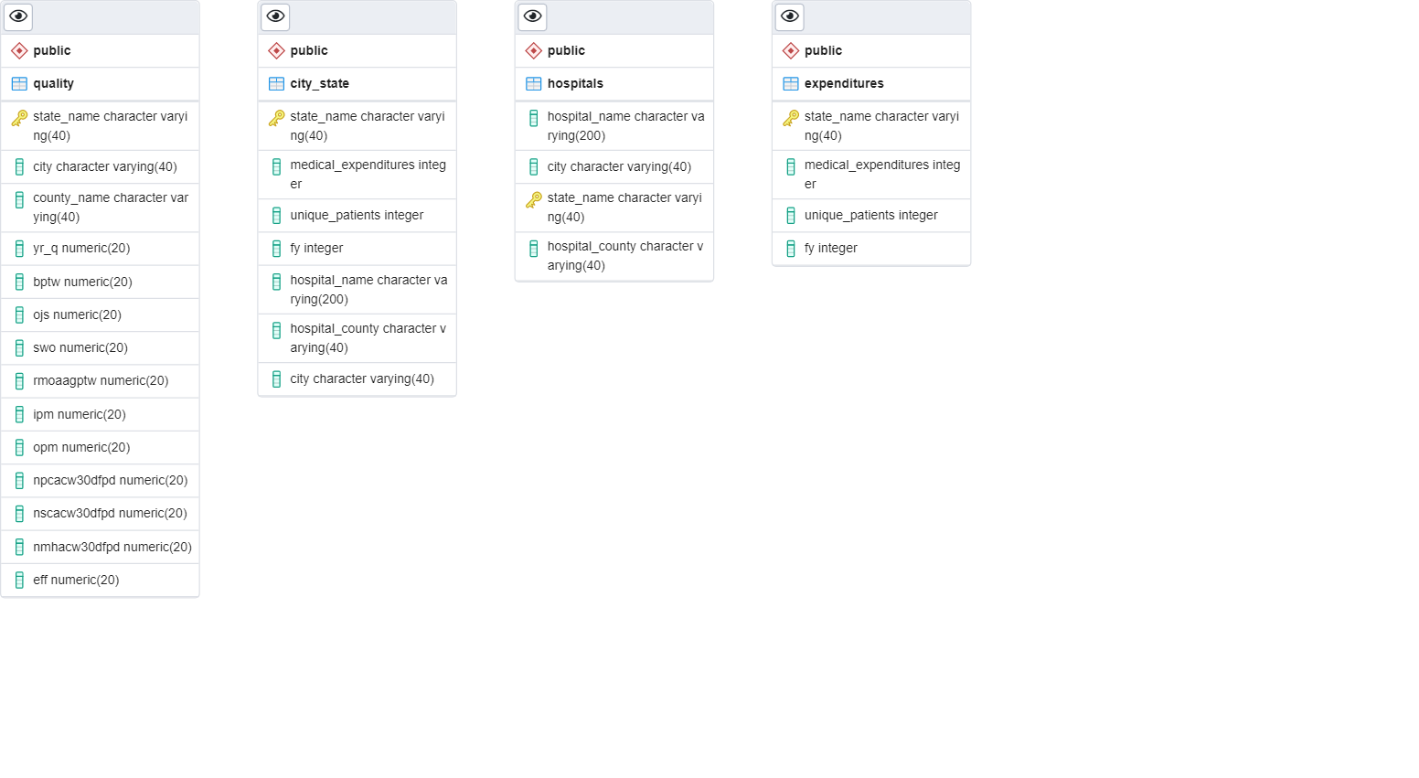
ERD

Slide 8
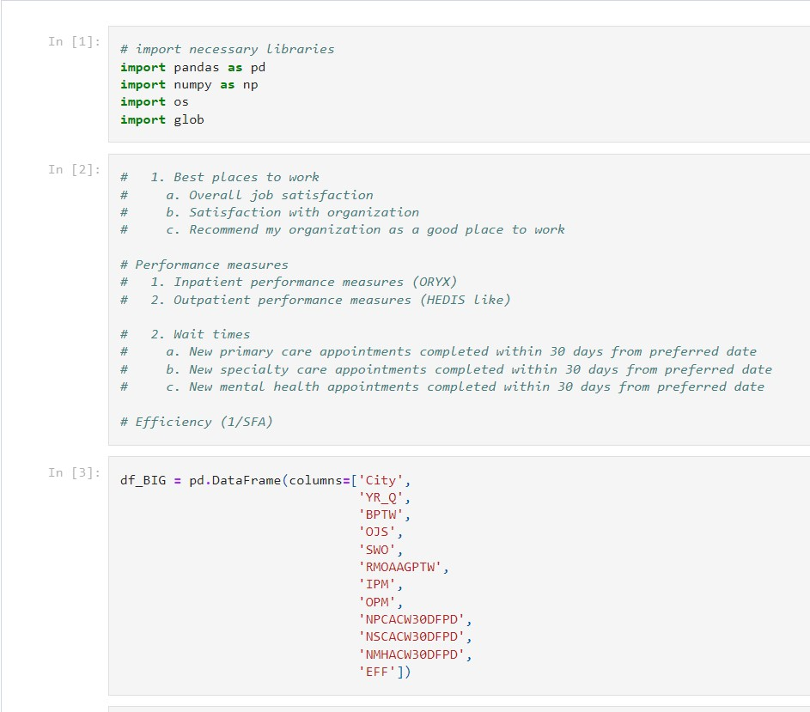
SAIL data extracted into Quality.csv using Jupyter Notebook.

Slide 9
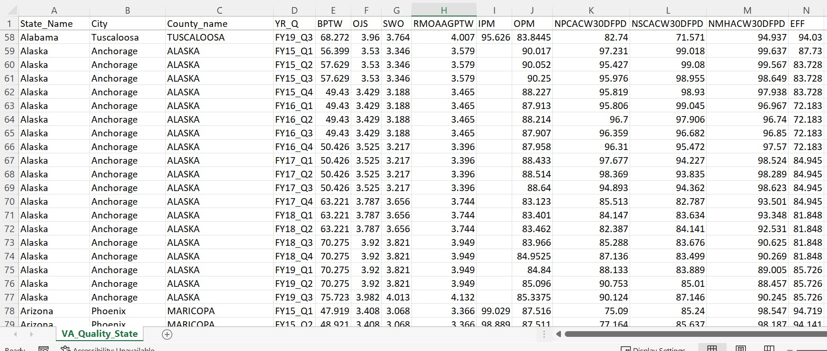
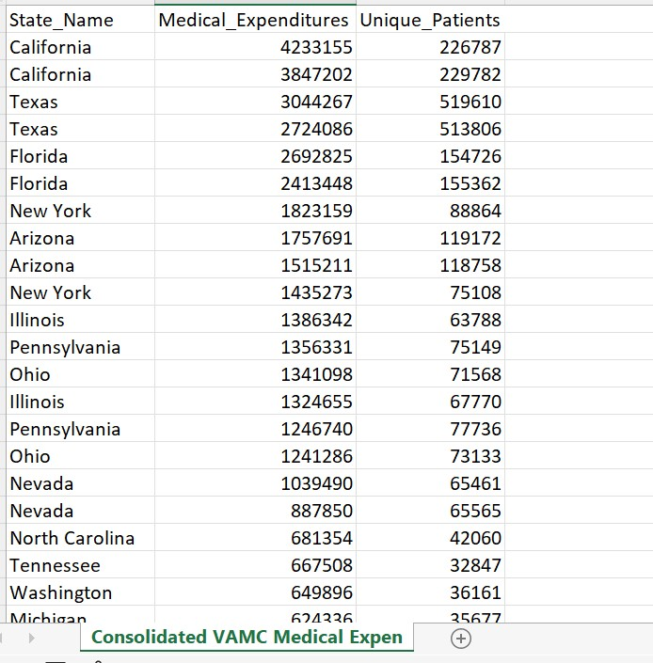
CSVs

Slide 10
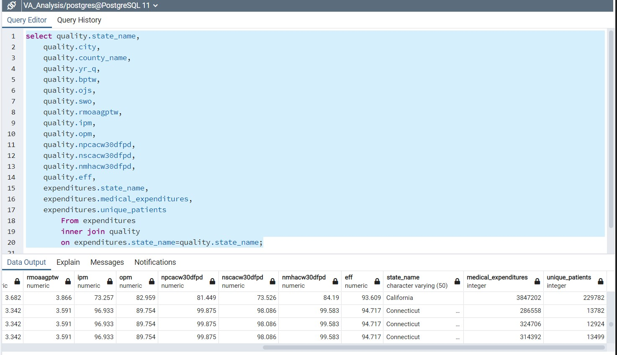
Joined Quality and Expenditures on state name to get Final dataset for model.

Slide 11
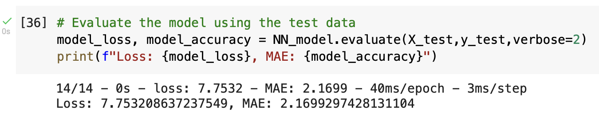
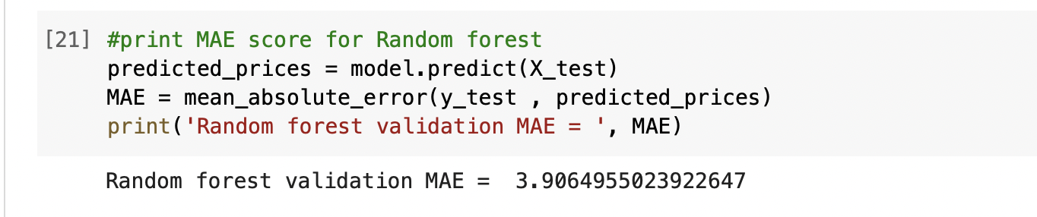
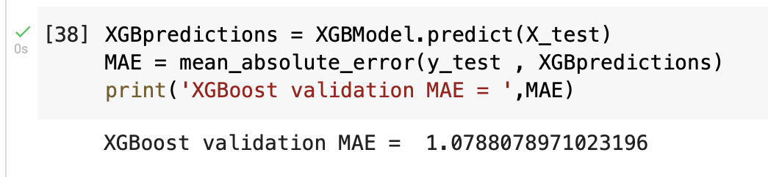
Machine Learning Model

Slide 12
We load and processed the dataset
We got familiar with the dataset by plotting some histograms and a correlation heat map of the features
We used a deep neural network with three hidden layers each one has 256 nodes.
We used relu activation function on the output layer
We trained the model then tested it.
We also tested two other models: XGBRegressor and Random Forest Regressor
Our XGBRegressor was able to outscore the other two models

Slide 13
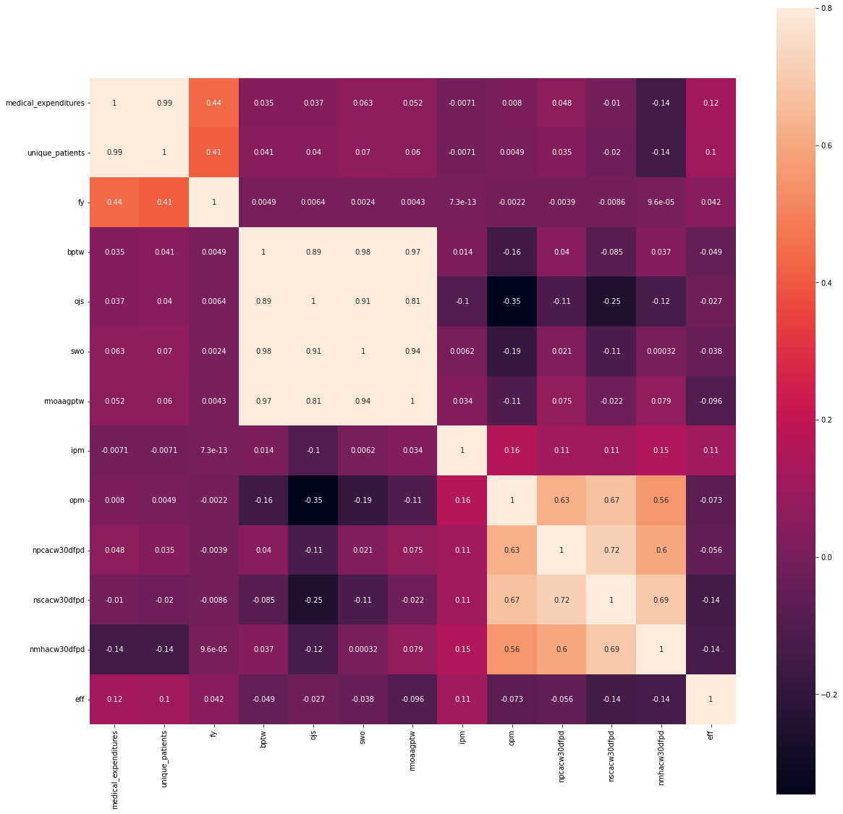

Slide 14
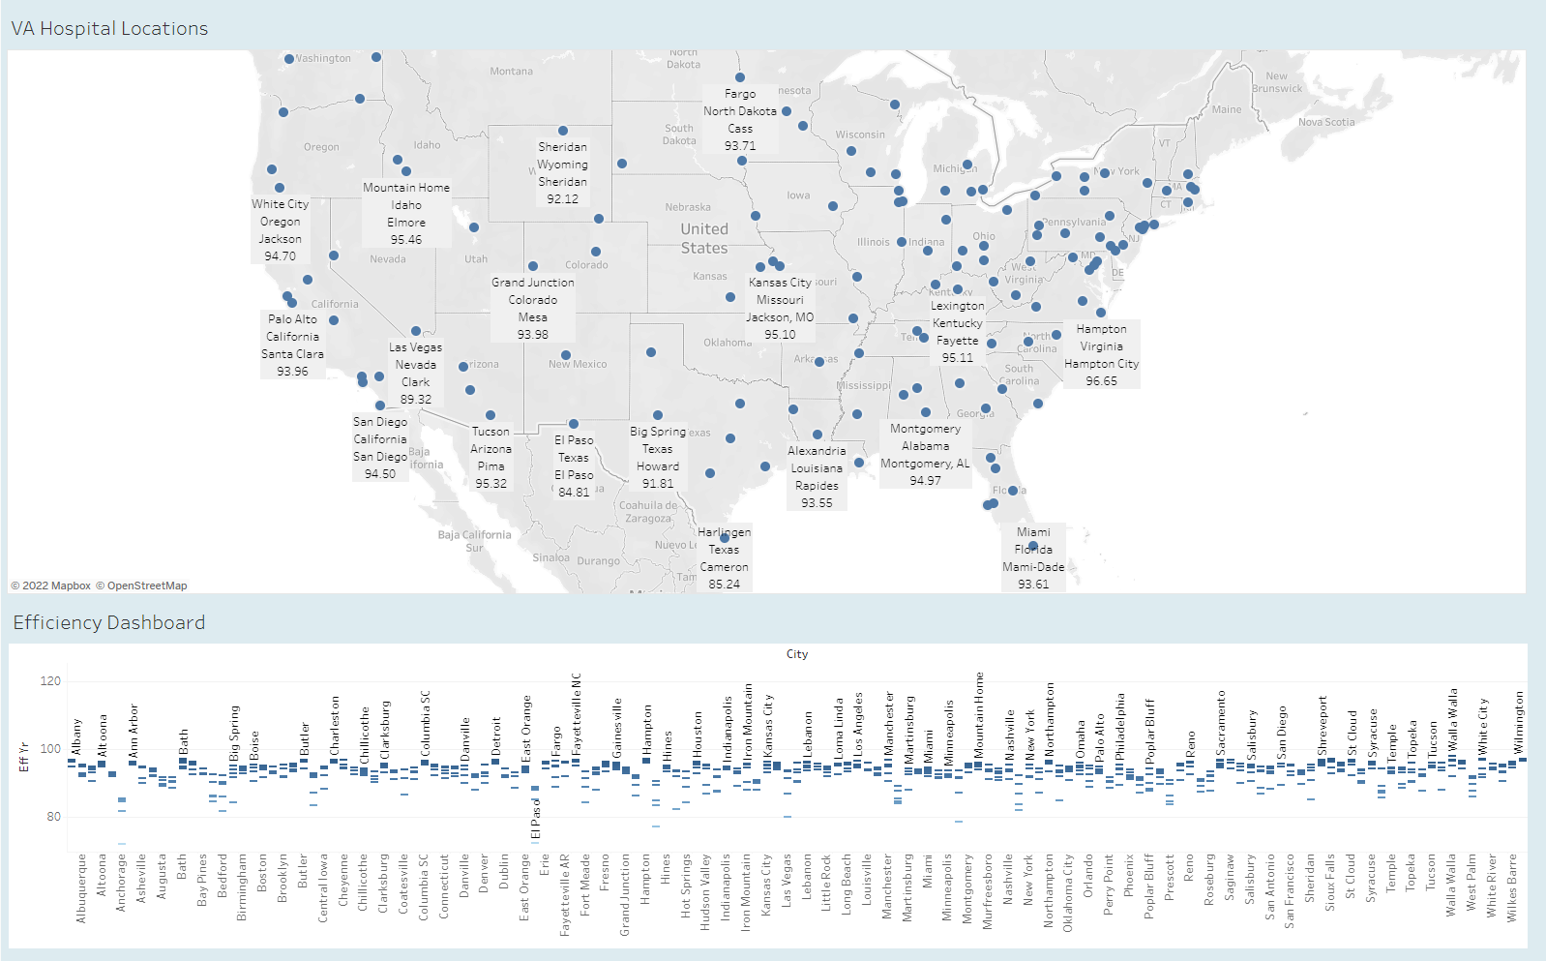
DASHBOARD

Slide 15


Thank You

